Slide 1
Agile

Slide 2
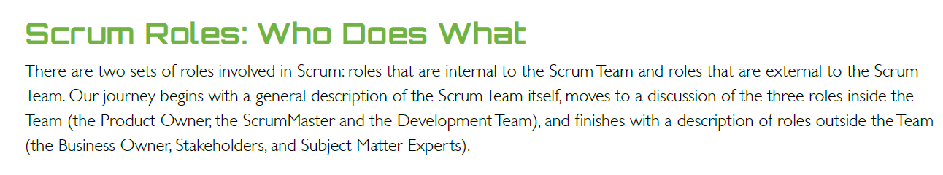
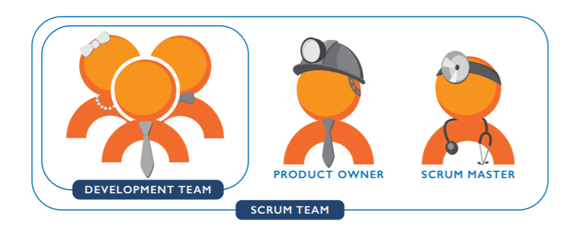

Slide 3
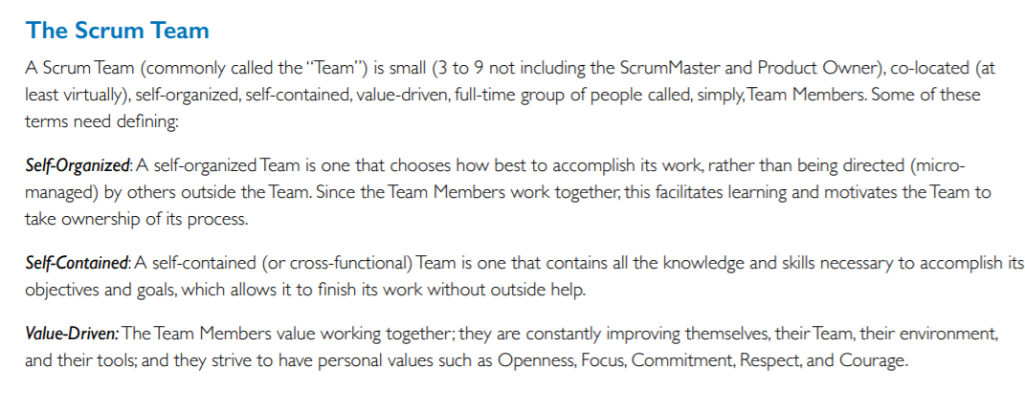

Slide 4
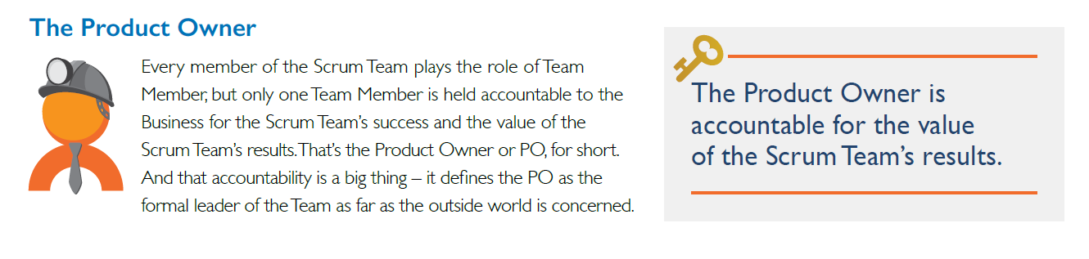
The PO is the Scrum Team’s eyes and ears to the outside world (to the Stakeholders).
He or she is the Scrum Team’s one point of formal contact
the PO is consumed with making sure the Scrum Team is getting the right feedback to make the right Product at the right pace.
We should also note that even though the word ‘Owner’ is in the title, the PO may not be the Product expert.
Granted, the PO has a whole lot of knowledge and skills, but the role is defined by the accountability, not by Product-specific skills.
A good PO realizes there may be a wealth of smarts both inside and outside the Scrum Team and knows how to leverage this for both the Scrum Team’s good and the Product’s good.

Slide 5
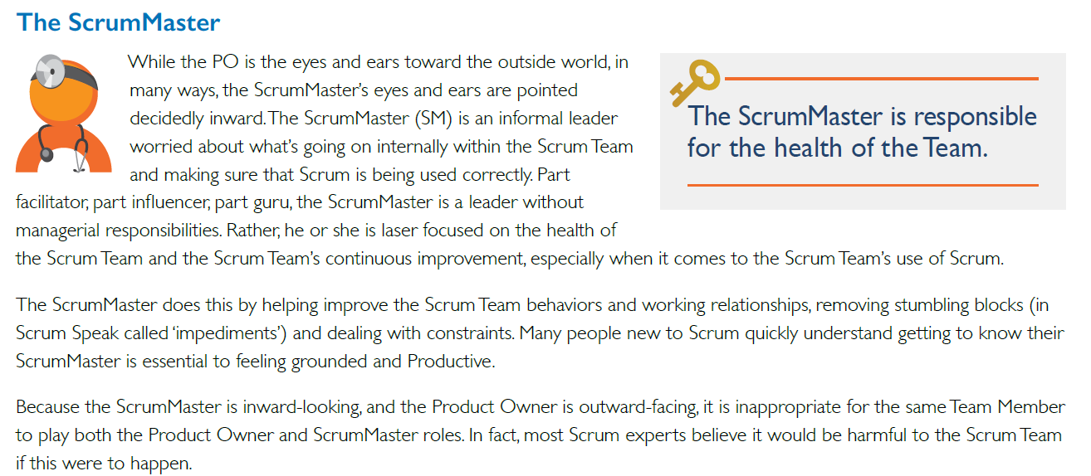

Slide 6
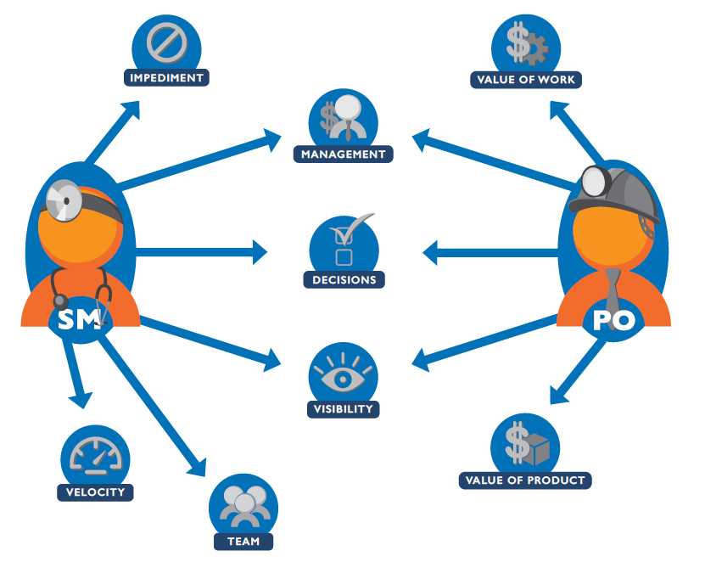

Slide 7
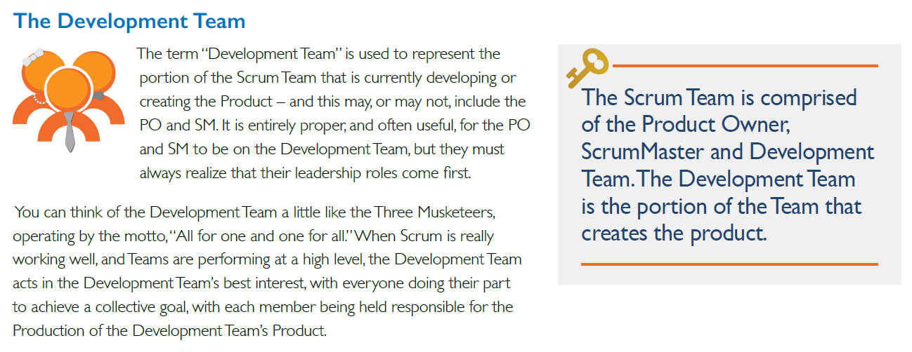

Slide 8
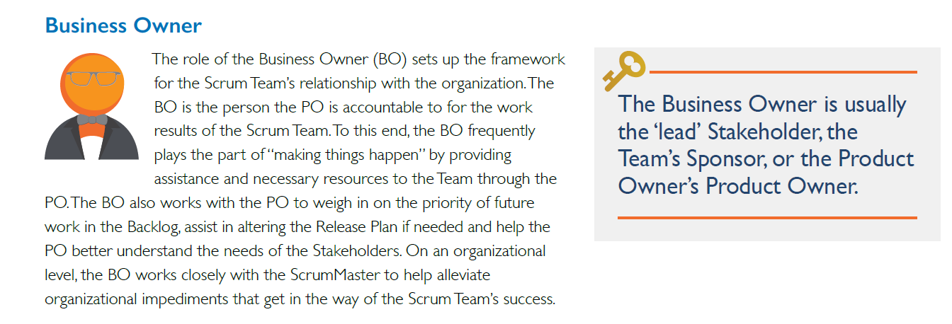

Slide 9
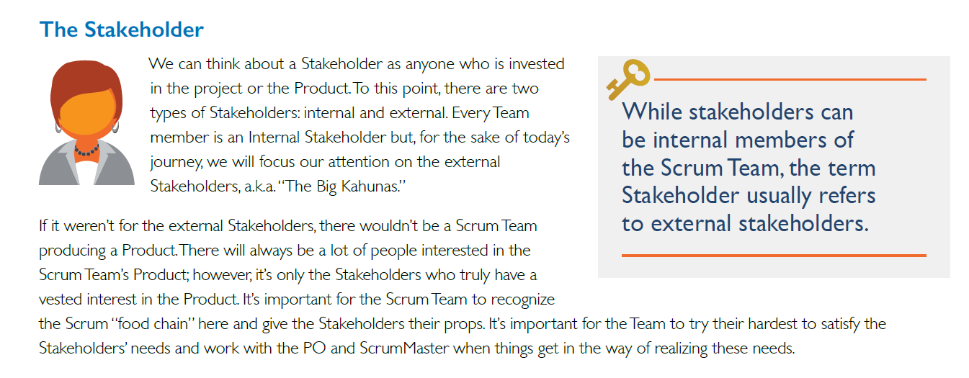

Slide 10
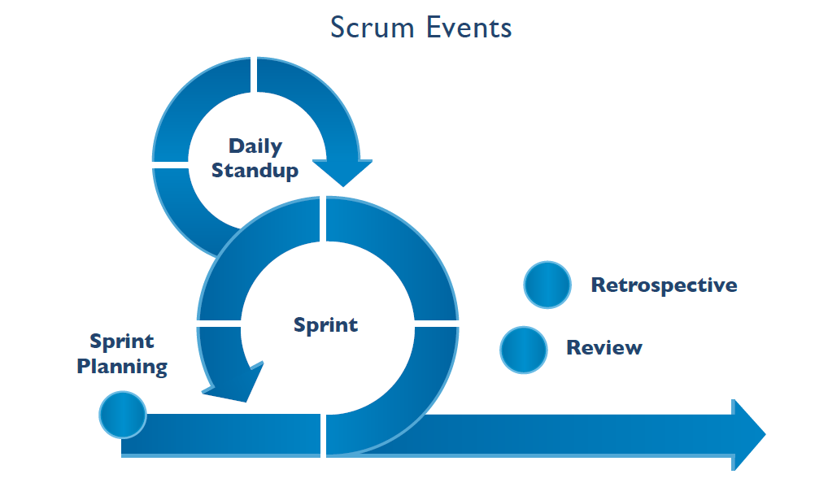

Slide 11
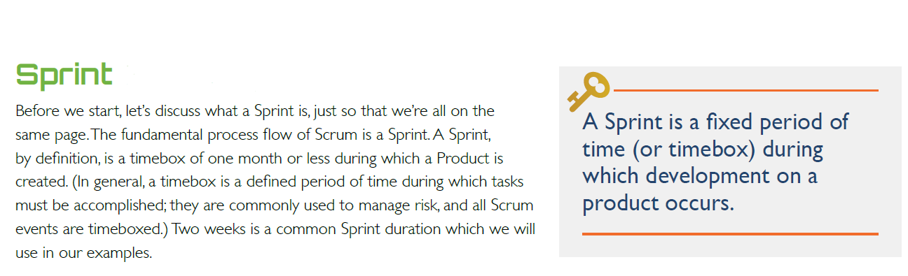

Slide 12
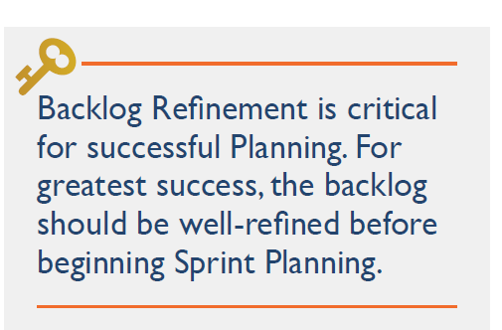

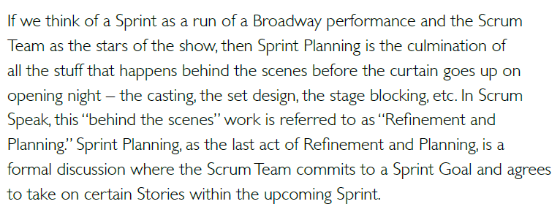

Slide 13
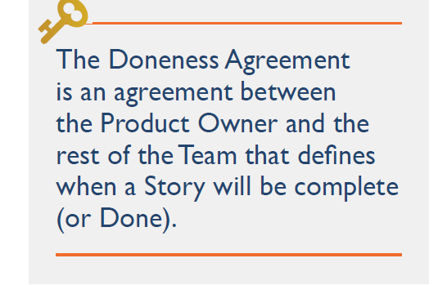
Sprint Planning is timeboxed. For a two week sprint, it should last no more than two hours
It begins with the Team discussing the upcoming Sprint’s goals and priorities
one-by-one the Product Owner selects a single Story from the Backlog
The PO discusses the Story and works with the Team to negotiate and finalize the Definition of Done for the Story
Make sure that the acceptance criteria is clear
Negations
the Stories for the Sprint are established
Definitions of Done are complete
the Sprint Goal has agreed on
ready to start the Sprint.

Slide 14
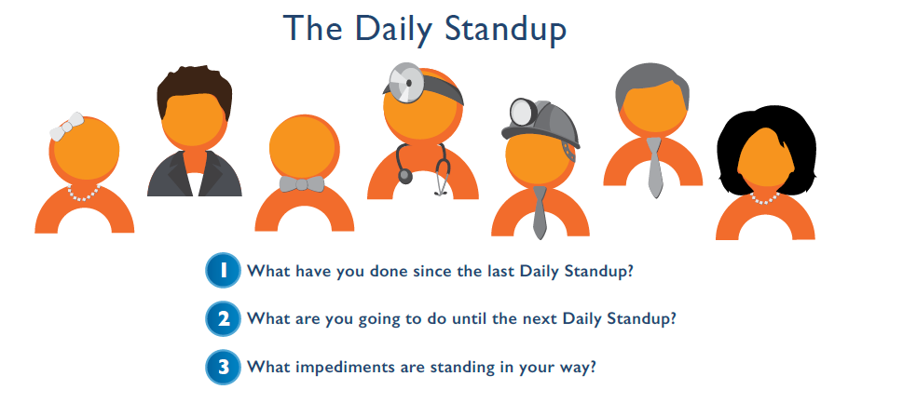

Slide 15
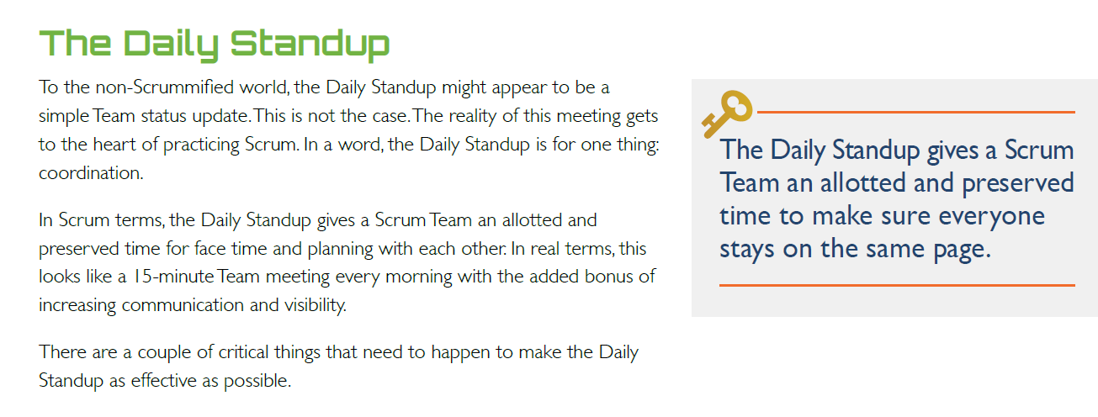

Slide 16
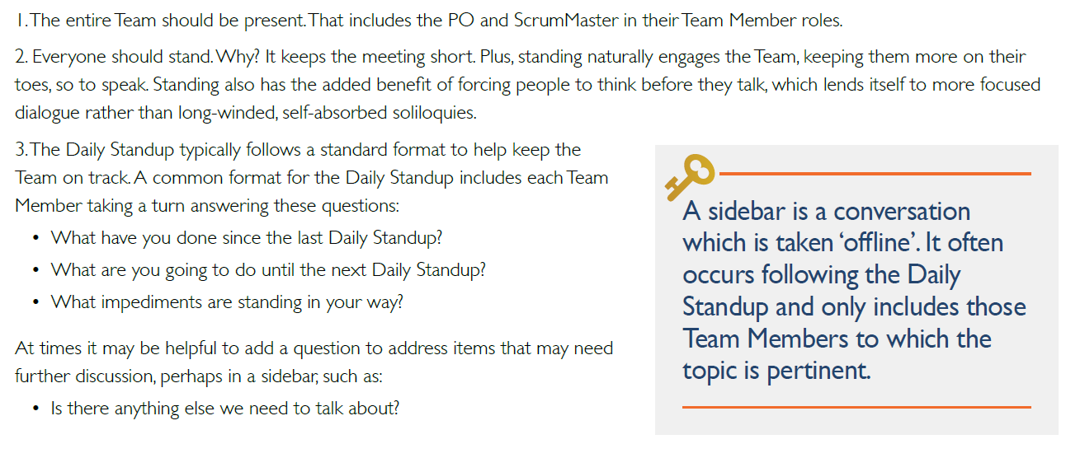

Slide 17


Slide 18
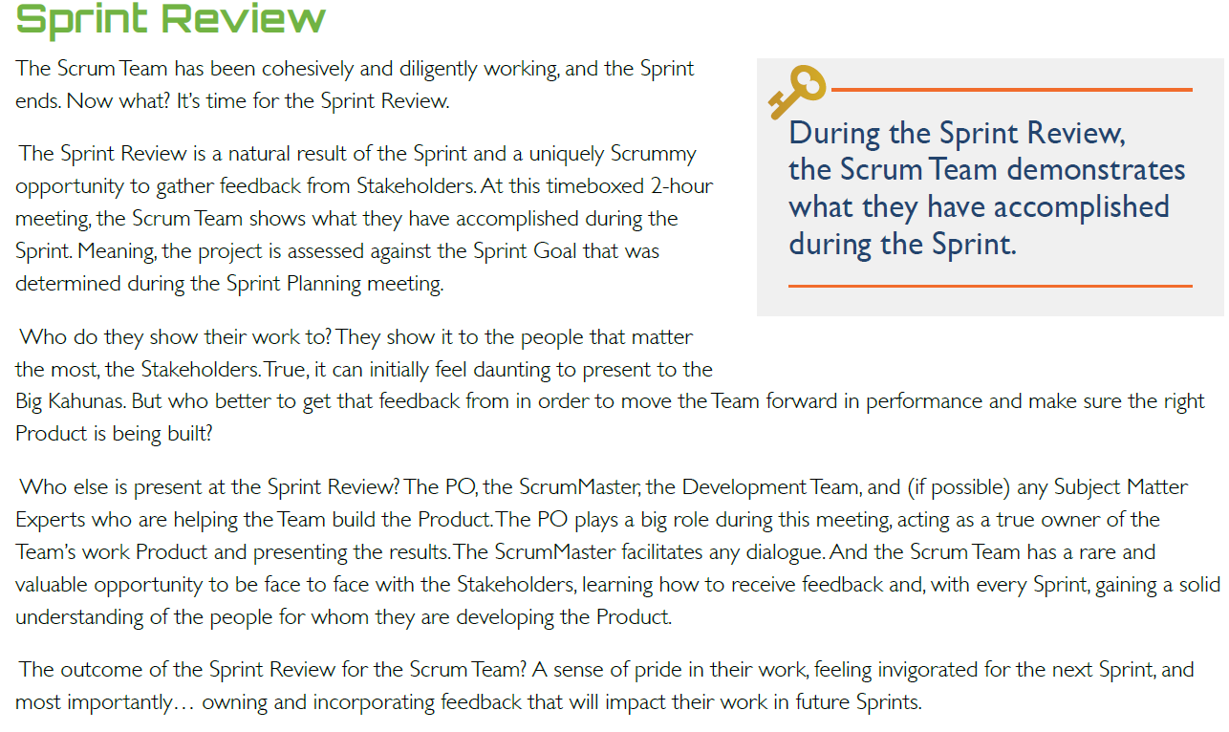

Slide 19


Slide 20
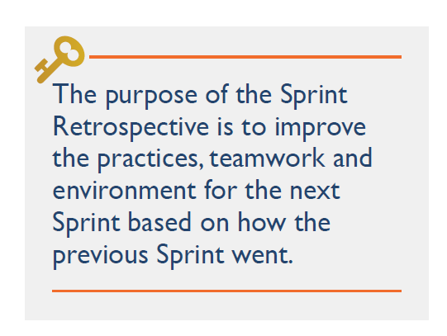
learn from the good things so we can repeat them and learn from the bad so we can improve immediately
The entire Team including the ScrumMaster and the PO
time boxed meeting
what went well and what ways could be improved

Slide 21
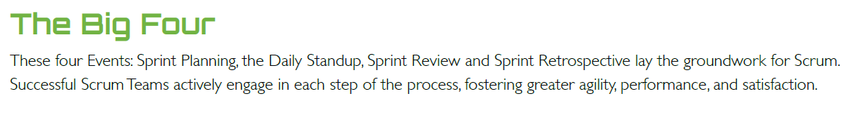

Slide 22
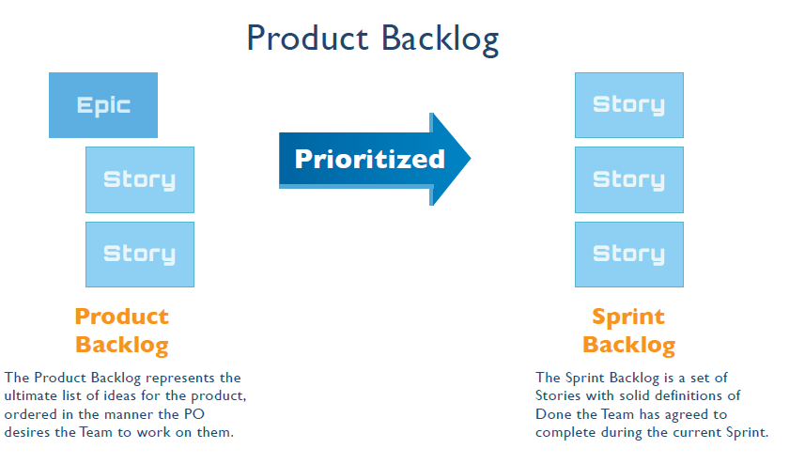

Slide 23
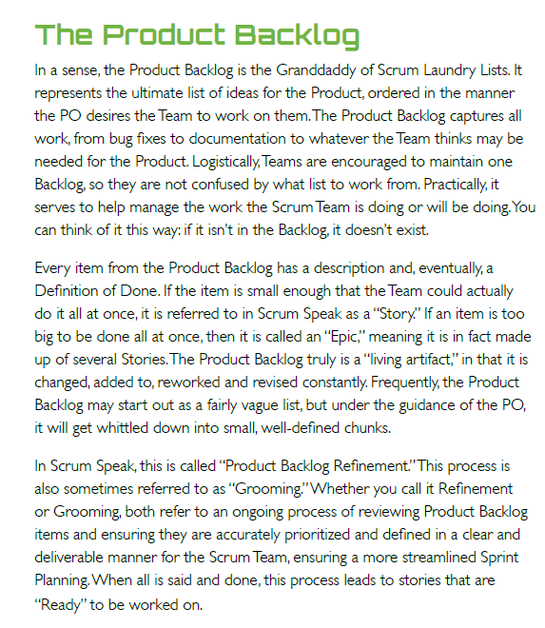
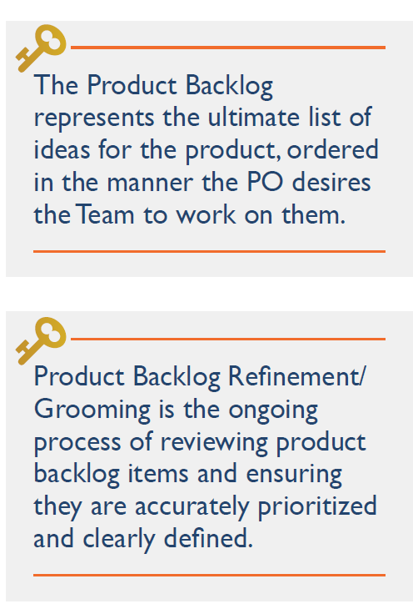

Slide 24
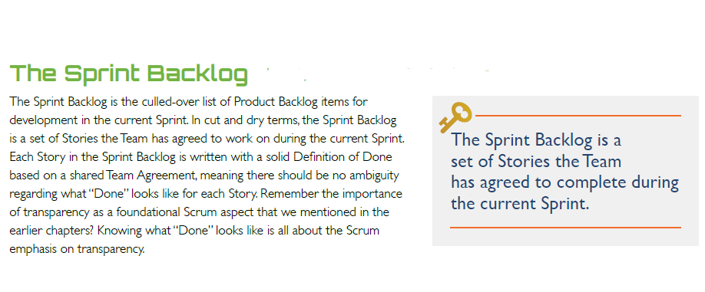

Slide 25
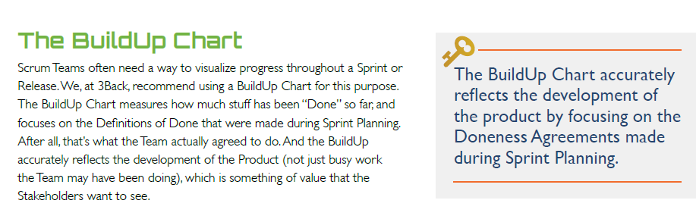

Slide 26
